Slide 1
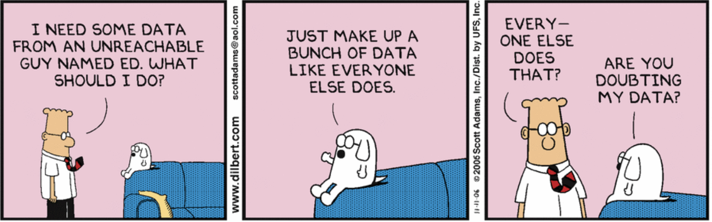

Slide 2
The MongoDB Aggregations
NoSQL Databases (DSO-553)
Prof: Arsames Qajar

Slide 3
Overview
Review Homework (q2) and questions
Review/Finish MongoDB Intro (logical operators & elemMatch)
Introduce Aggregation Pipeline

Slide 4
$not, Implicit/Explicit $and, $elemMatch
Implicit/Explicit $AND
-2 operations done on the same field e.g. { … year: {gt:2000}, year: {$lt:2005} ...}
-multiple $or operators
$not, $ne & $not,
-$ne comparison operator to a single value
-$not logical disjunction, includes fields that do not match or do not exist
-can be thought of as $and where all values or expression are negated
$elemMatch
-syntax⇒ { <field>: { $elemMatch: { <query1>, <query2>, ... } } }
Notes:
$nor
-can be thought of as $and where all values or expression are negated
-syntax⇒ { $nor: [ { <expression1> }, { <expression2> }, ... { <expressionN> } ] }

Slide 5
Aggregation Pipeline

Slide 6
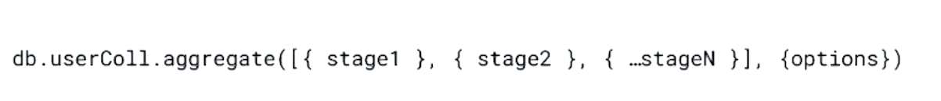
Aggregation Framework cont’d
Set of analytics tools within MongoDB that allows you to run various reports or analysis on one or more MongoDB collections.

Slide 7
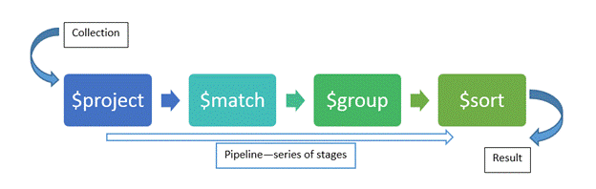
What is the Aggregation Framework?
Set of analytics tools within MongoDB that allows you to run various reports or analysis on one or more MongoDB collections.

Slide 8
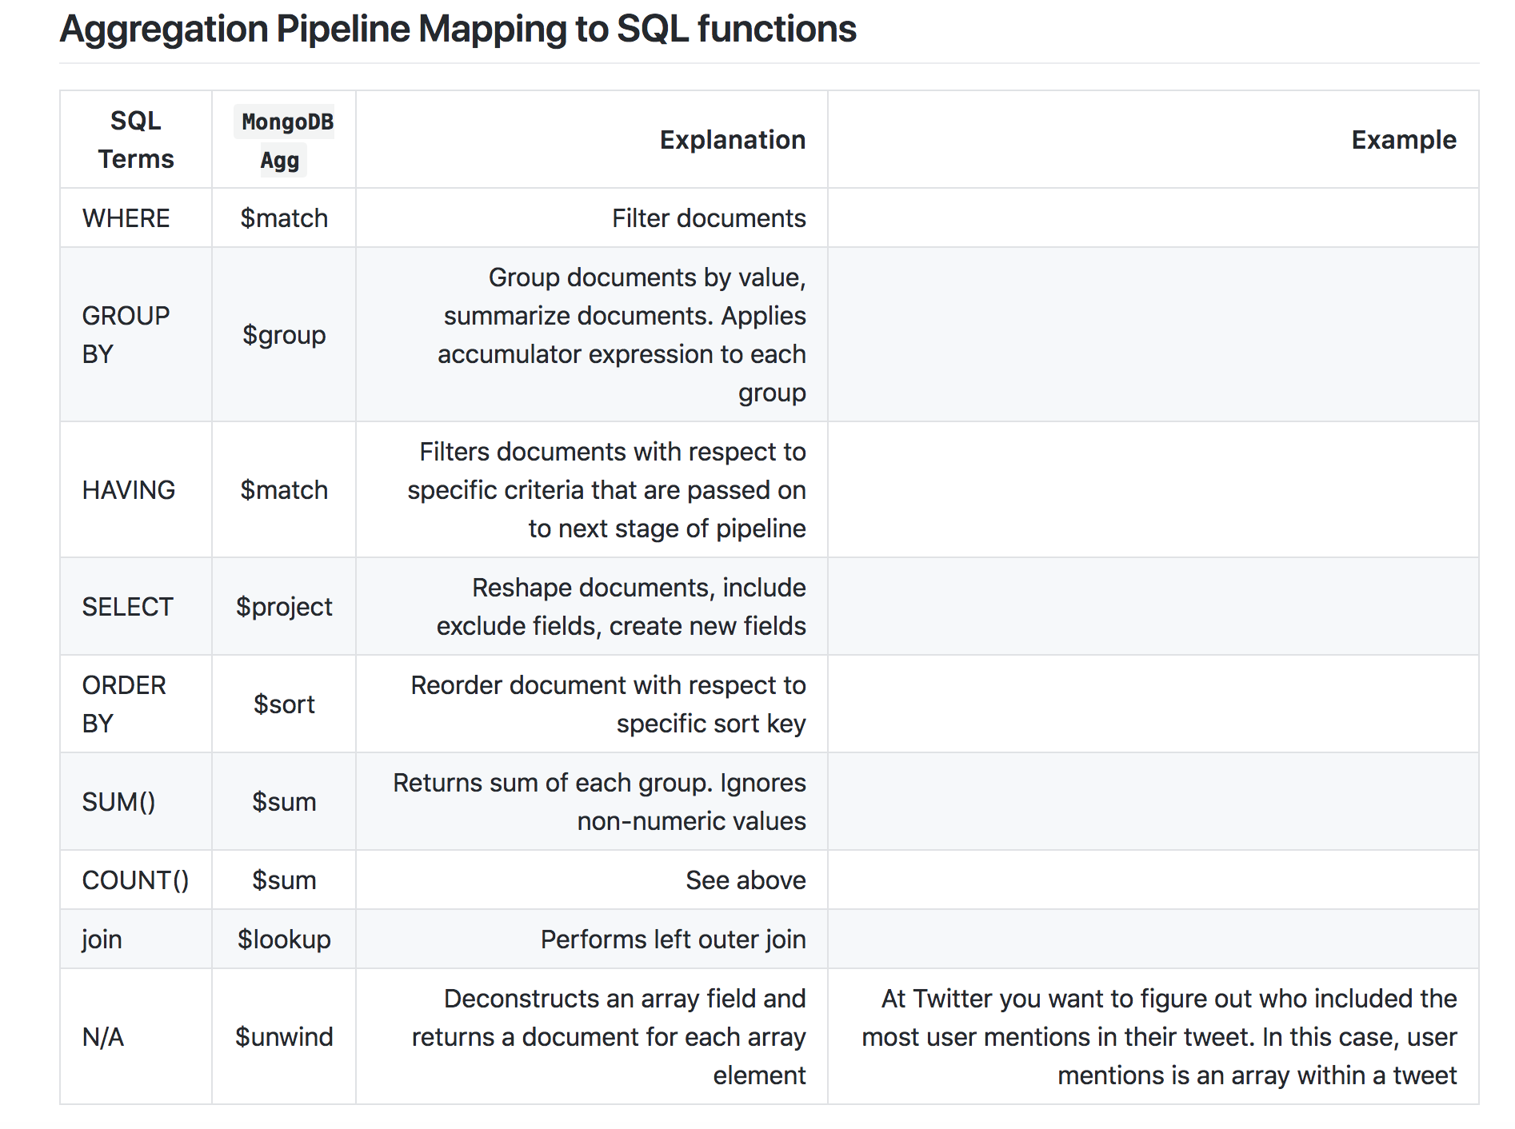

Slide 9
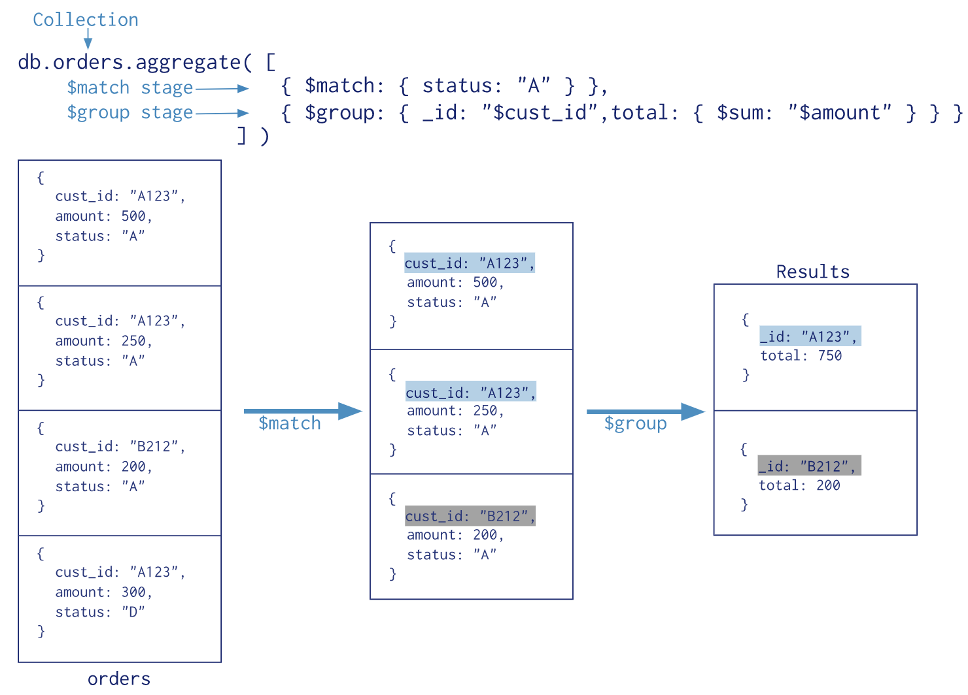
The Pipeline - example 1

Slide 10
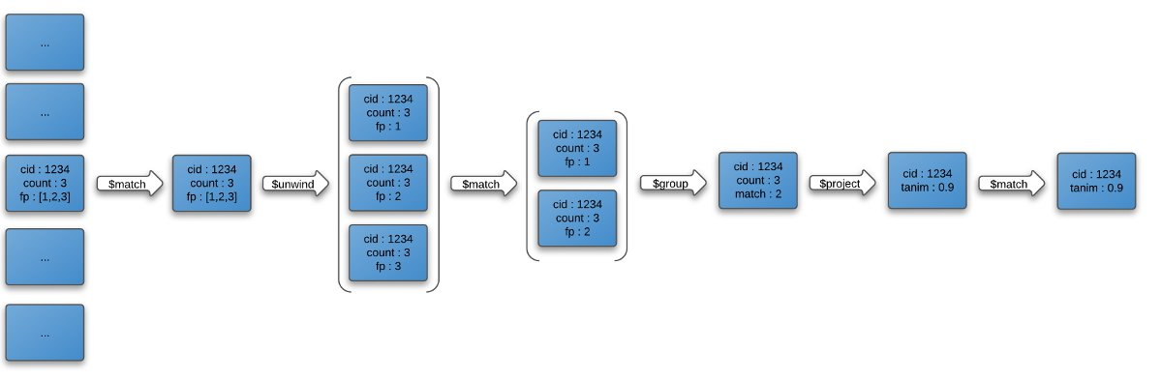
The Pipeline - example 2

